Slide 1
MULTIPLE CHOICE QUESTIONS
JUMP STATEMENTS

Slide 2
1. In the context of "break" and "continue" statements in C, pick the best statement.
A | “break” can be used in “for”, “while” and “do-while” loop body.
B | “continue” can be used in “for”, “while” and “do-while” loop body.
C | “break” and “continue” can be used in “for”, “while” and “do-while” loop body. But only “break” can be used in “switch” body.
D | “break” and “continue” can be used in “for”, “while” and “do-while” loop body. Besides, “continue” and “break” can be used in “switch” and “if-else” body.
Solution: C
“continue” can be used in loop body only. “break” can be used in loop body and switch body only.

Slide 3
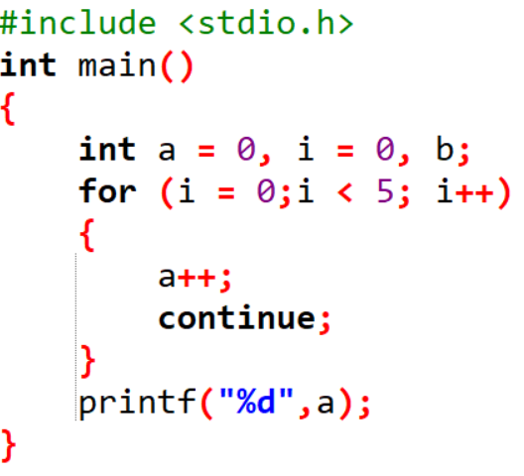
2. What will be the output of the following C code?
a) 2
b) 3
c) 4
d) 5
Solution: D

Slide 4
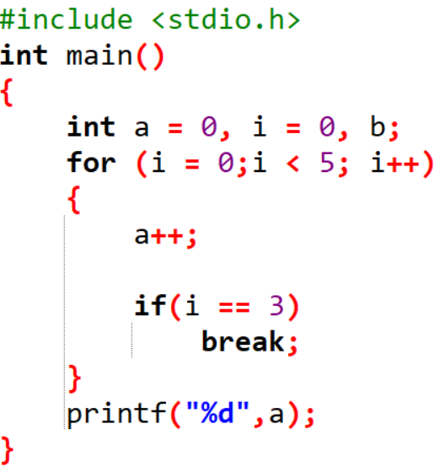
3. What will be the output of the following C code?
a) 1
b) 2
c) 3
d) 4
Solution: D

Slide 5
4. Which keyword is used to come out of a loop only for single iteration?
a) break
b) continue
c) return
d) none of the mentioned
Solution: B

Slide 6
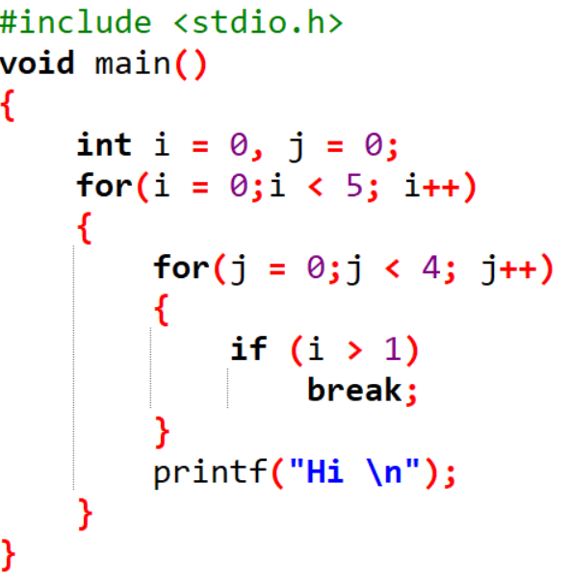
5. What will be the output of the following C code?
a) Hi is printed 5 times
b) Hi is printed 9 times
c) Hi is printed 7 times
d) Hi is printed 4 times
Solution: A

Slide 7
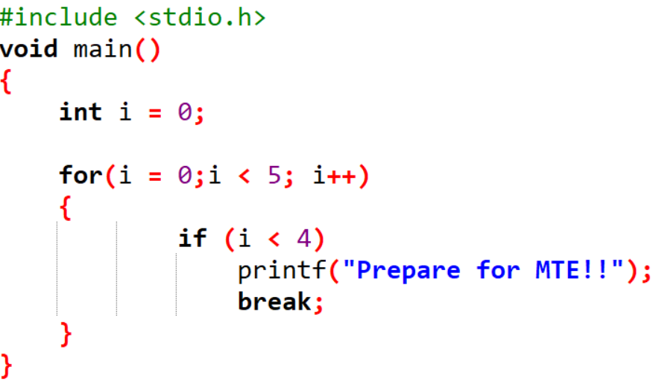
6. What will be the output of the following C code?
a) Hello is printed 5 times
b) Hello is printed 4 times
c) Hello
d) Hello is printed 3 times
Solution: C

Slide 8
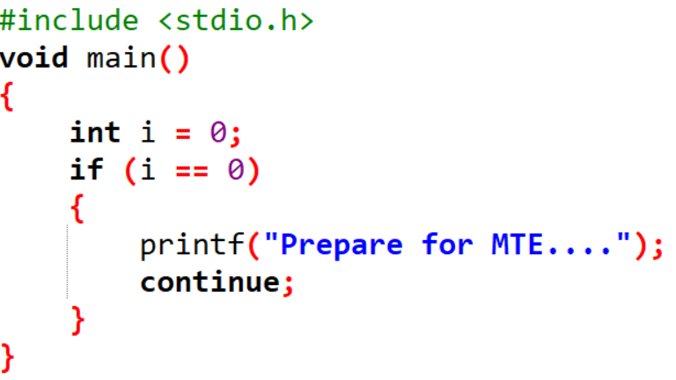
7. What will be the output?
a) Prepare for MTE…. is printed infinite times
b) Prepare for MTE….
c) Varies
d) Compile time error
Solution: D
“continue” statement not within loop

Slide 9
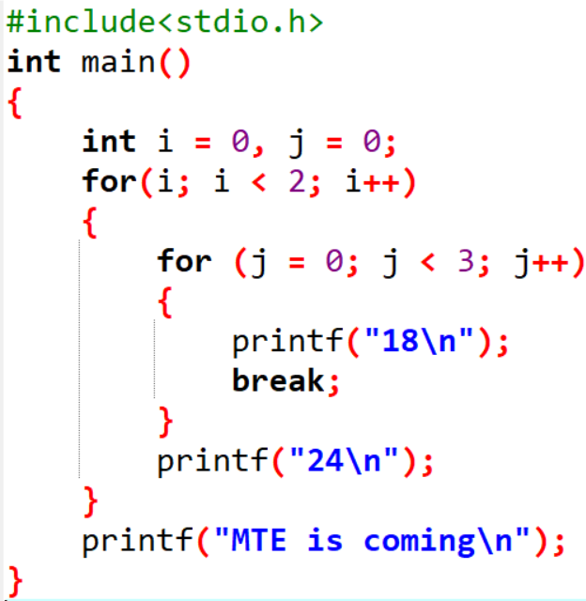
8. What will be the output of the following C code?
a) 18
24
MTE is coming
b) 18
MTE is coming
c) 18
24
18
24
MTE is coming
d) ) 18
18
24
MTE is coming
Solution: C

Slide 10
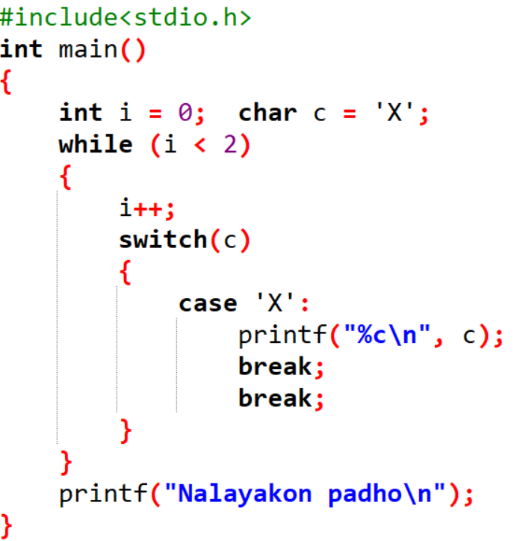
9. What will be the output of the following C code?
X
Nalayakon padho
b) X
X
Nalayakon padho
c) Nalayakon padho
d) None of the mentioned
Solution: B

Slide 11
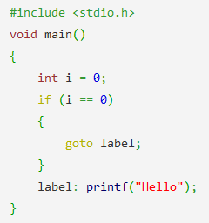
10. What will be the output of the following C code?
a) Nothing
b) Error
c) Infinite Hello
d) Hello
Solution: D

